Slide 1

Notes:
Slide 1 - Introduction: Good afternoon Mr Jones, Mr Smith, thank you for taking time out for the presentation today with Synergy Solutions. We are very excited to present to you our solutions to your problems, which we are confident will exceed your expectations.
Are there any questions you would like to ask before we start ? You will also have the opportunity to ask any questions that you may have at the end.

Slide 2
In today’s presentation we will cover the following :
Background
Limitations of Existing System(s)
Aim/Objectives
Investigation of Comparable Systems/Current user views
Proposed Solution
Features/visual representation of Proposed Solution
Commercial Constraints
Conclusion

Slide 3
Background
The Synergy Solutions software development company was approached by Matthew Jones, the current zoo manager at Claybrook zoo, who wanted us to develop a suite of software products that includes a website, visitor information & self-service style technologies and records management system.
In response to the problem, we have developed a range of products that exceeds your expectations.
Notes:
Hi my name is madhab. A couple a month ago matthew jones came to synergy solution with concern about the current business operation of claybrook zoo. Due to the lack of technology with in the company, claybrook zoo was missing opportunities in expanding their out reach and were liable to damages because of their paper based system. My college Elizabeth will tell you more about the current limitation of the existing system

Slide 4
Limitations of Existing System(s)
Lack of storage space
Time consumption for retrieval & editing process
Prone to damage & weak security
Lack of technology - less outreach
Signage - updated once a year, as not technical.
Less attraction due to the lack of publicity.
High costs & environmentally damaging
#
Notes:
The paper documents can take up a considerably large amount of space with the quantity of it increasing day by day. With this being said, it would have to be stored close to hand so that it can be easily accessed, which again its an issue in regards to space within the business that could be used for better instances.
Additionally To retrieve documents upon request takes a while as the documents have to be collected from filing cabinets. To edit the documents, it will take long and more time you’d have to write the whole thing again which means it’d have to be repeated every single time you want to make corrections
Paper records systems are very prone to being misplaced, lost and even as well as being stolen. This can cause high security and data protection issues with data being mishandled or in the hands of the wrong people with no permission. It can also be damaged in the sense where if there were to be an incident such as a fire or if water were to be exposed to the cabinets, the whole paper system would be ruined and there would be no way of retrieving these documents as there are generally no back ups. Additionally speaking, ink tends to wear out over time and paper gets old, therefore some information can also be interpreted wrongly or erased full stop.
The lack of technology within the system means poor or little to no communication between staff, customers and partners. Due to lack of technology and no social platforms available this means less outreach for more customers or sponsors, which in turn doesn’t help with the increase of revenue and exposure for the company.
It is not aesthetically pleasing in news age as most establishments require a social media face to boost its publicity
Costs for tones of papers, printers, inks, stationary, photocopier office supplies etc. also it is
Environmentally damaging in the sense that using more paper is bad for the environment and it won’t help much to boost the company’s green credentials. As in todays day and age many of todays employees, customers or even partners want to work for businesses that provide sustainability

Slide 5
Aim/Objectives of project
The key aim of this project is to develop an effective and efficient suite of products which includes:
A customer facing zoo website
internal facing visitor information technologies
A zoo records administration/content management system that will allow key business records for the zoo to be effectively managed.
Notes:
For the objectives we as a team achieved this by taking on feedback from various groups that charter not only those who work within the zoo but those who also attend the zoo, who would like to attend and those who attend other establishments similar to the zoo. This goes without saying the demands we have to meet up to mesh with those of the key stakeholders and knowledge of our software team to provide the best software solution there is possible for Claybrook zoo.

Slide 6
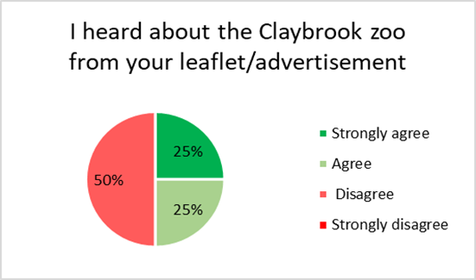
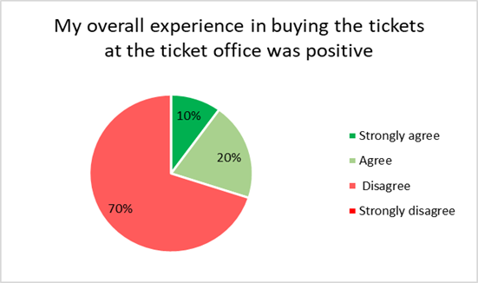
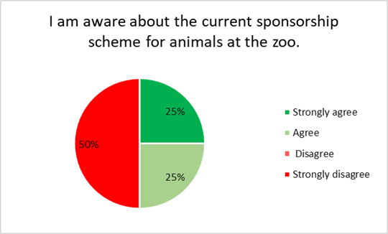
Investigation of Comparable Systems/Current user views
These are the results from the questionnaire:
Notes:
These are the key findings we gathered from current visitors at claybrook zoo via the questionnaire that we believe should be incorporated to the new system
So the first pie chart shows… we need to work more on our outreach and implementing a website with ads, and social platforms with promotions will help us drastically in doing so (incorporate a study finding?)
The second pie chart
If you are curious to know about the findings of the rest of the questionnaire please feel free to let us know at the end and we will send you an email in regards to these findings.

Slide 7
Comparable Systems - website
The table below compares the effectiveness of features on competitor websites
Feature | Whipsnade Zoo | Colchester Zoo | Chester Zoo | ZSL London Zoo
Usability | 4 | 4 | 5 | 4
Layout | 4 | 4 | 5 | 3
Speed | 4 | 4 | 4 | 4
Navigation | 3 | 5 | 4 | 3
Colour Scheme | 3 | 5 | 5 | 3
Images | 3 | 3 | 5 | 4
Key: 1 = Not at all effective, 2 = Slightly effective, 3 = Moderately effective, 4 = Very effective, 5 = Extremely effective

Slide 8

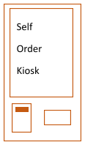

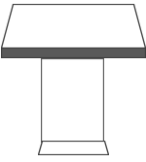
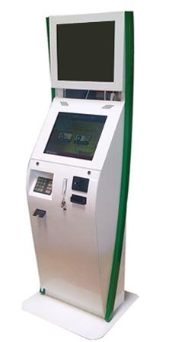
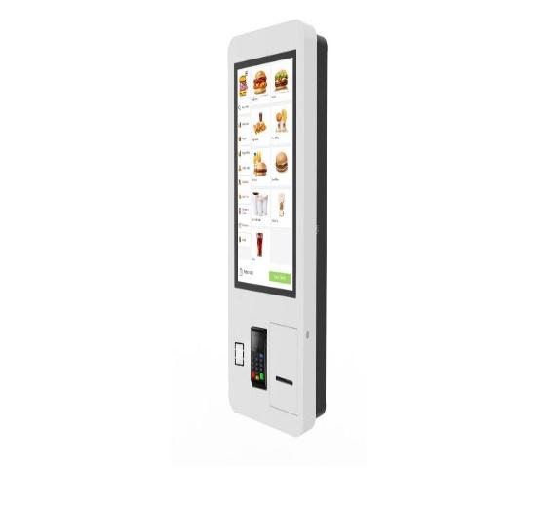
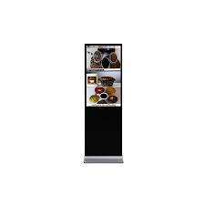
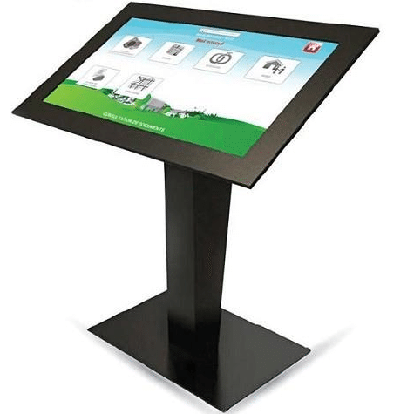
Comparable Systems - Kiosk
 | Bank Kiosk | Self Order Kiosk | Product Promotion Kiosk | Informative Kiosk
Design
Model Example

Slide 9
Proposed Solution (1 slide)
RMS
We have come up with a solution to resolve the current paper based system. We believe our solution is :
Easy to use
Easy to access
Efficient
Reliable
Spacious

Slide 10
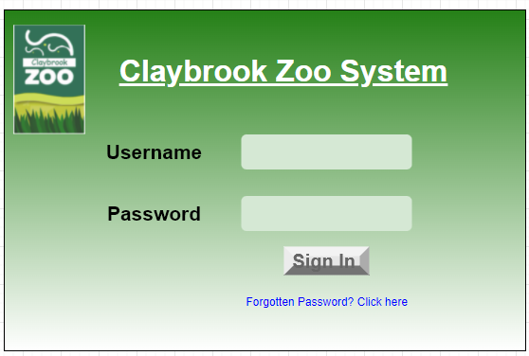
Record Management System Mockups
Key features.
Employees are given unique code
Easy to Login
If the password is forgotten it can easily be reset.
Notes:
Things that need to be mentioned.

Slide 11
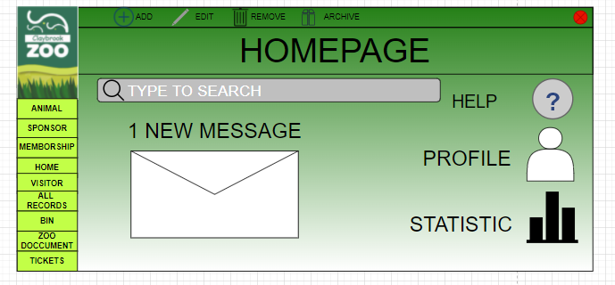
Key features.
It is easy to choose a page.
Clear and easy to read.
Statistics can be viewed for senior admins on profits and losses.
There is a help button which will give you easy steps to use the RMS.

Slide 12
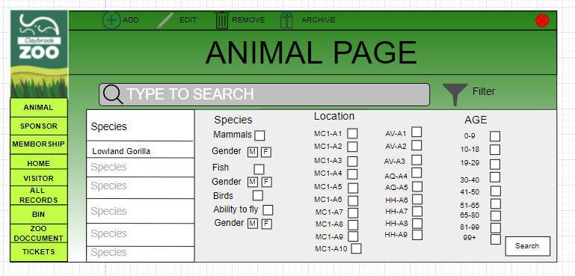
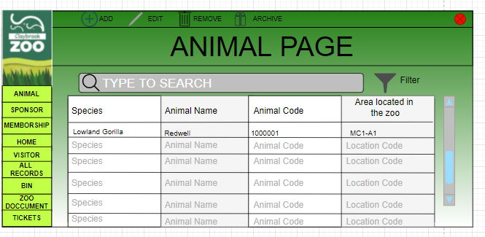
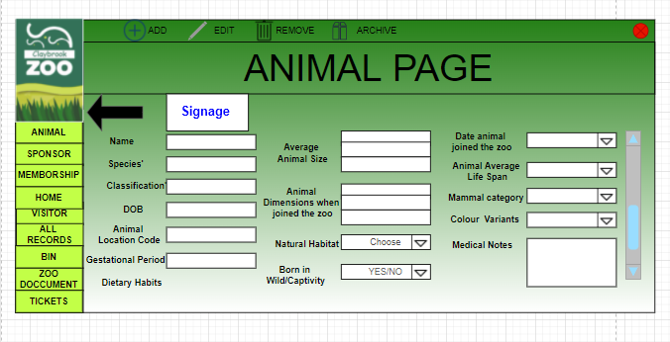
Key Features.
Easy to view.
Can search by multiple filters.
Animal details can easily be changes.
Editing and searching is simple and easy.
Notes:
The information and details about the animals such as what they like to eating habitat etc need to also be stored on the rms.
All documents should be stored in alphabetical order with the surname as the primary name used.
The signage needs to be updated yearly so should be easy to update.
The RMS should have the option to filter sponsors by how long they have left on their sponsor and when they need to renew it.
The designs for the new signage need to be able to be store on the RMS and updated through there.
For documents such as the signage you should be able to store drafts, share and make dynamic changes.
ID number.

Slide 13
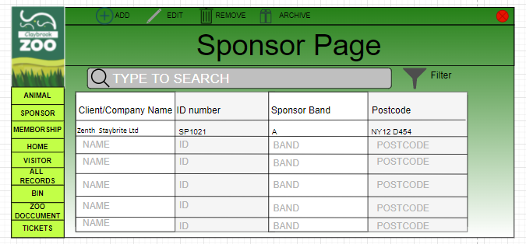
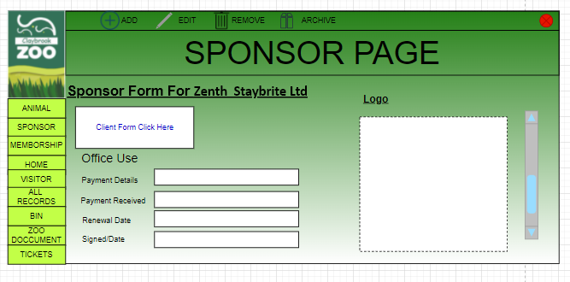
Key features.
It is easy to search for sponsors.
Easy to Add sponsors.
Easy to edit Sponsor details.
Quick and easy access to Sponsor Details.
Notes:
Requirements met:
Sponsors' data needs to be stored on the RMS in addition they need to be easily accessible.
All documents should be stored in alphabetical order with the surname as the primary name used.
The RMS needs to hold all the details about the customer such as personal and sensitive data such as contact details bank details.
The RMS should have the option to filter sponsors by how long they have left on their sponsor and when they need to renew it.
The RMS should have a search bar to search for animals,sponsors and other documents.
Every document should be given a number relating to their sector such as memberships should be given a membership ID number.
If a sponsor becomes a sponsor via a website or other methods their data should automatically be added to the RMS.
The sponsors should fill out their own forms electronically primarily with the option of doing it by paper and these documents should be directly added once the customer fills out each of their required details.

Slide 14
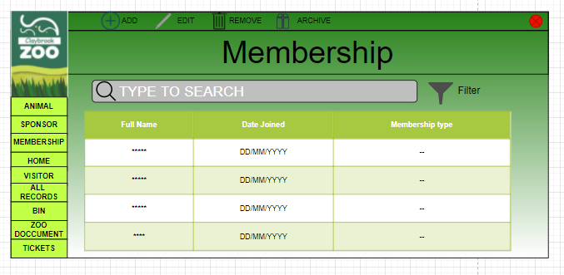
Key features.
Easy to Add Members.
Easy and Clear to read.
Can search and filter.
Notes:
There are many membership types a few to remember is adult, child and joined membership.

Slide 15
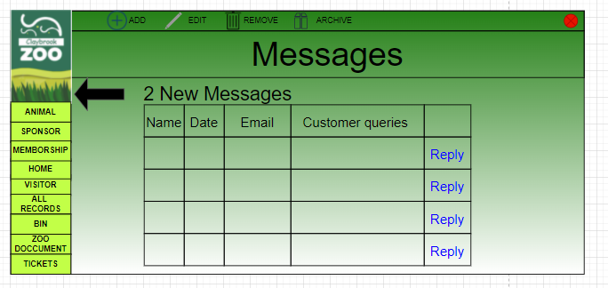
Key features.
Clear Easy to read
Ordered by date oldest to newest.
Easy to reply to customers..
Notes:
The key features will entail

Slide 16
Proposed Solution
Website
The problem we are trying to solve through the website is the lack of outreach and to encourage more visitors to the zoo. Therefore the solution we have come up with is a website that is:
User - friendly
Easy access
Child friendly
Advertises key events
Signing up to a newsletter
Easy to use - no training needed
Book tickets
Managing your account details on the website

Slide 17
Website Features
The key website features include:
Sign Up to the newsletter
Social media icons - more outreach
Members page
Sponsors page
Contact Us page
Key events coming up at the zoo
Renew membership on your account online
Leave a comment feature on the home page
Animal of the week

Slide 18
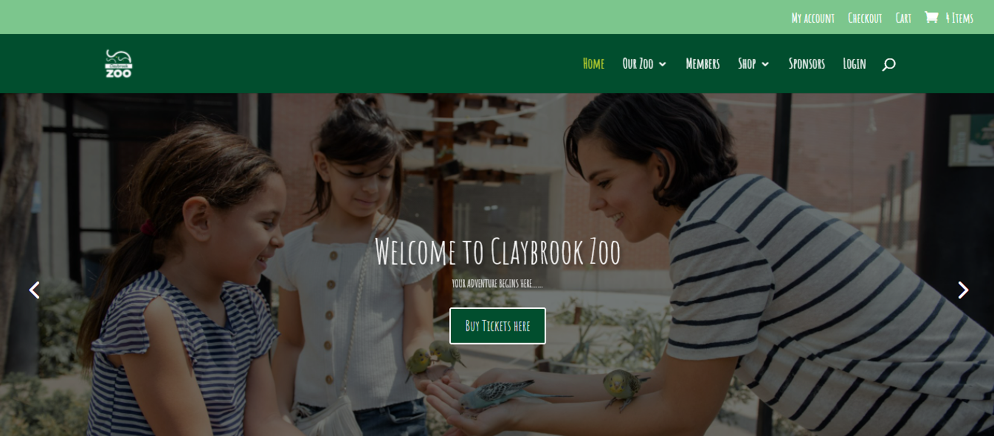
Website mock-up
Link to the website: https://thestoreshack.com/zoo/
Notes:
My account section colour scheme needs to be changed (colour clashes)

Slide 19
Proposed Solution
Kiosk
The problems we are trying to solve through the new kiosk system are the long queues at the entrance and poor flow within the zoo. Our solution:
Decreases queuing
Creates a better flow within the zoo
and therefore increases the profitability of the zoo and creates new streams of profit.

Slide 20
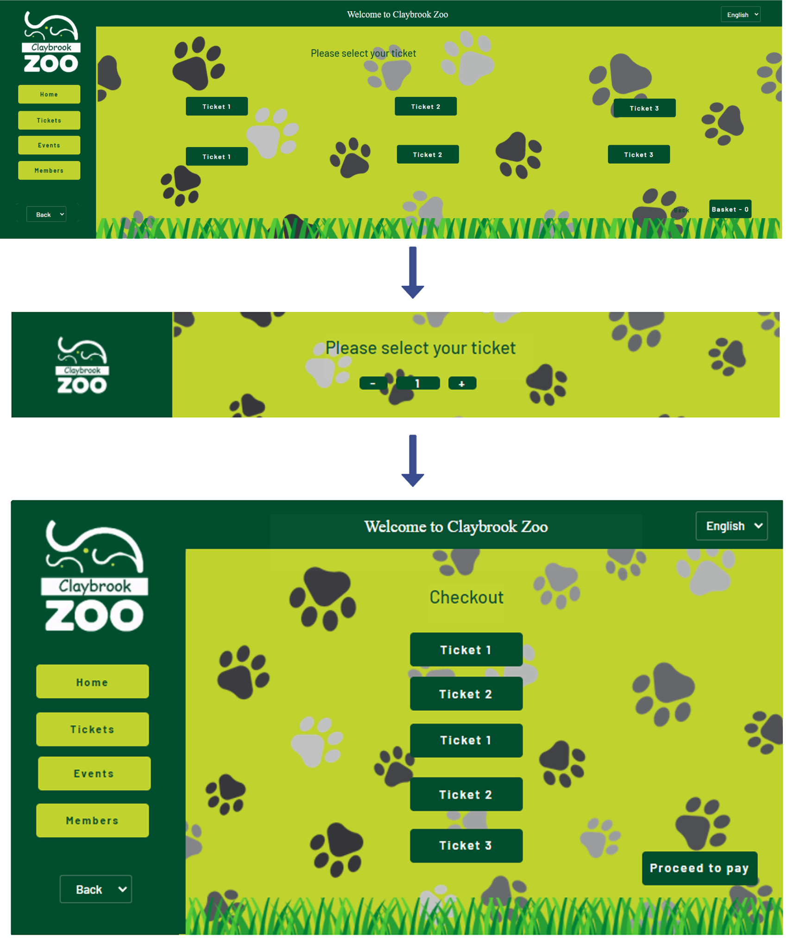
Proposed Solution
Kiosk - Ticket/Shopping kiosk
Main points of the Ticketing booth:
Self explanatory system
Different buttons that sums up anything the buyer needs
Events checker button to see what is happening at the zoo in the future
Members button for the customers to be able to purchase memberships directly from the booth

Slide 21
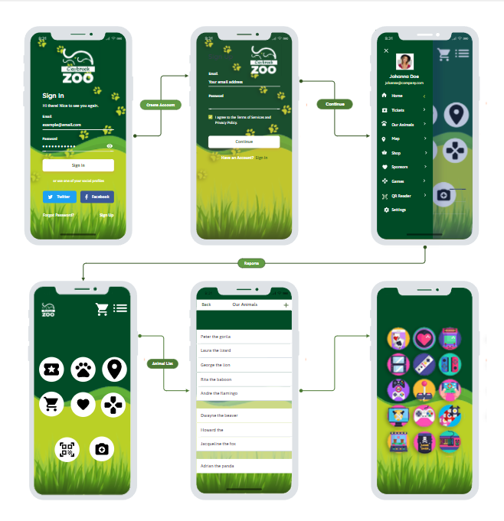
Proposed Solution
Kiosk - Mobile app
Key features:
Able to buy tickets
Membership details
Animal informations
Pre-order merchandise
See current sponsors
Locations GPS
Games
And more…
Notes:
Thank you lisa, my name joel i am also with the kiosk team and i will be introducing the mobile app and its 7 main features
Our first and most important feature is the ability to buy tickets on the mobile app.
Membership details- Our membership feature informs visitors of their current membership plans, it allows the each member to view their membership expiry and personal details they’ve given to the zoo
Animal info - The animal info feature gives biographies for all the animals at the zoo.
Pre order merchandise - This e-shop feature allows customers to buy zoo merchandise that can be collected on their next visit to the zoo.
Sponsors - Gives customers a rundown of the sponsors to the zoo, and what animals they sponsor
Location GPS - interactive maps allow guests to see their exact location and navigate easily around the zoo, also assists visitors with choosing the fastest and the most accessible routes around the zoo
Games - We have multiple animal-oriented ideas, our main currently being a qr code scavenger hunt that interacts with the whole zoo.
If there are any features you may want us to include that haven’t been mentioned already, we can apply them to the mobile app in future talks

Slide 22
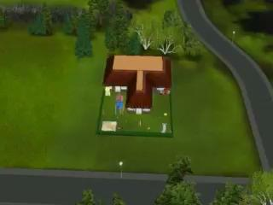
Proposed Solution
Kiosk:
As a way of bringing this idea to life, we have devised a building that is fully equipped with :
Toilets
Gift Shop
Food kiosks
Different gaming machines
Toys chests
Backyard playground
Notes:
This is a 3d model prototype for our kiosk building.
Thank you I will not passs it onto my colleague Madlina

Slide 23
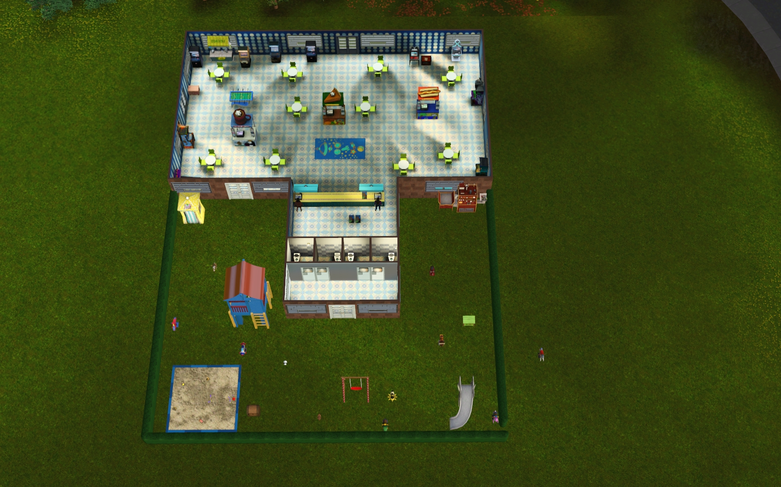
Playground area
The Playground area is equipped with:
Playhouse
Toys chests
Photo booth
Sand box
Swings
Multiple riding animals

Slide 24
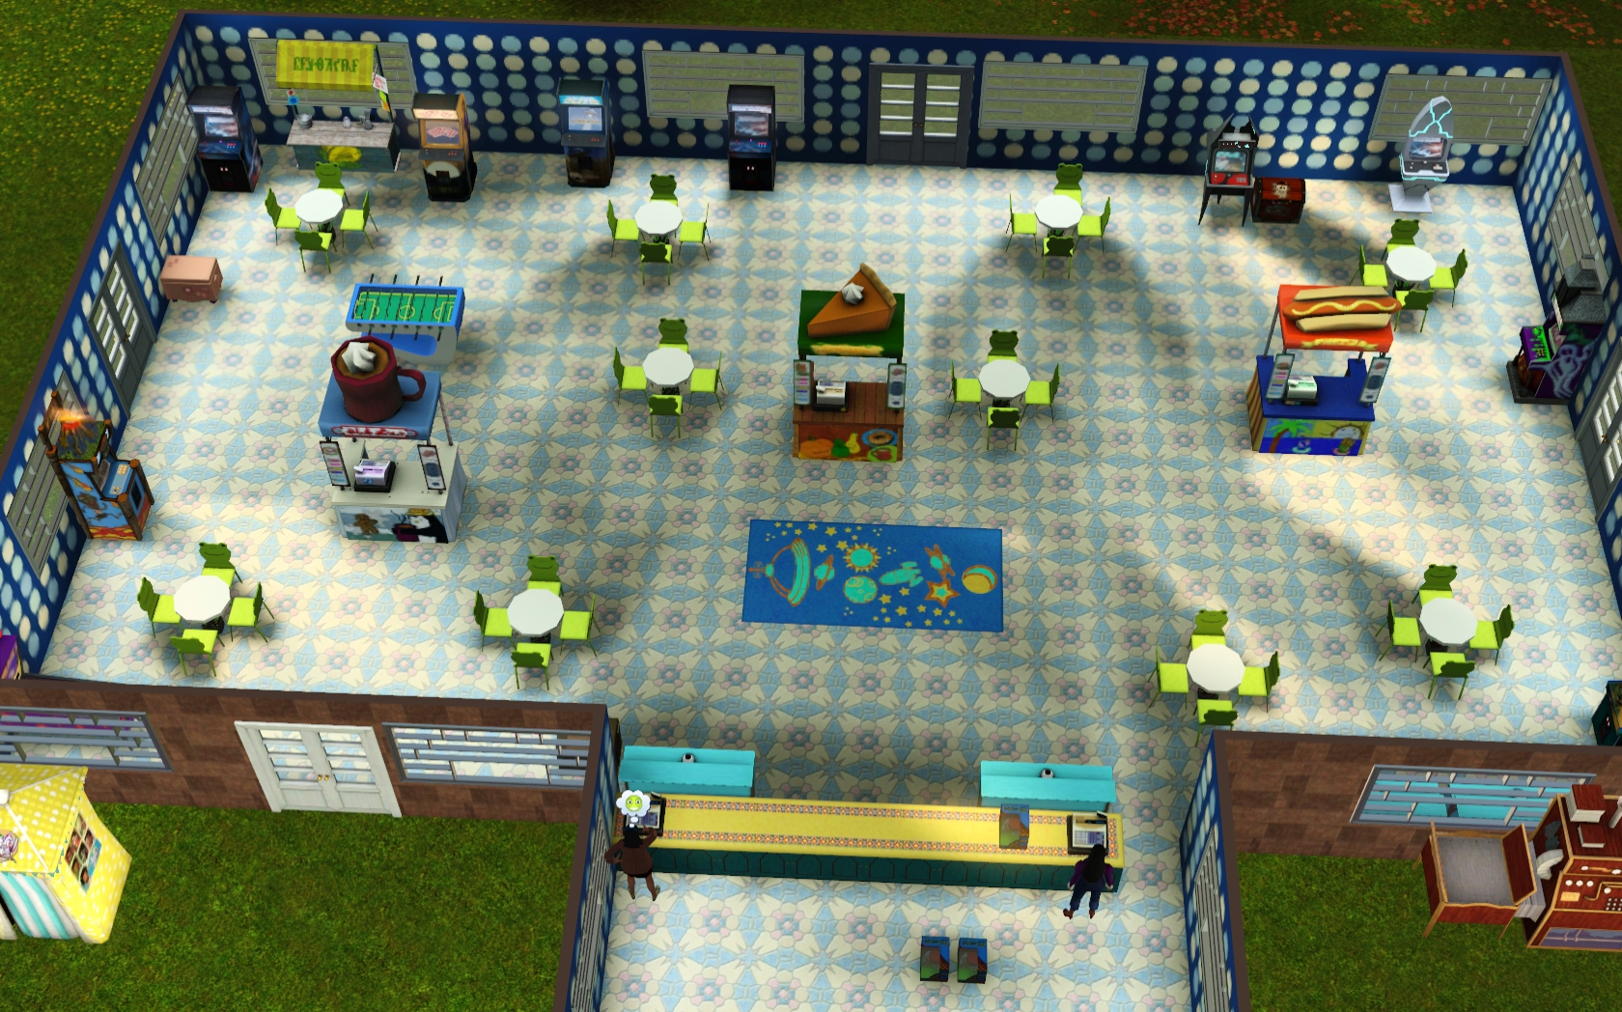
Inside venue
Inside the venue we have :
Lemonade stand
Hot dog stand
Lemonade stand
Hot drinks stand
Food and drinks vending machines
Tables
Multiple games activities
Toy chests

Slide 25
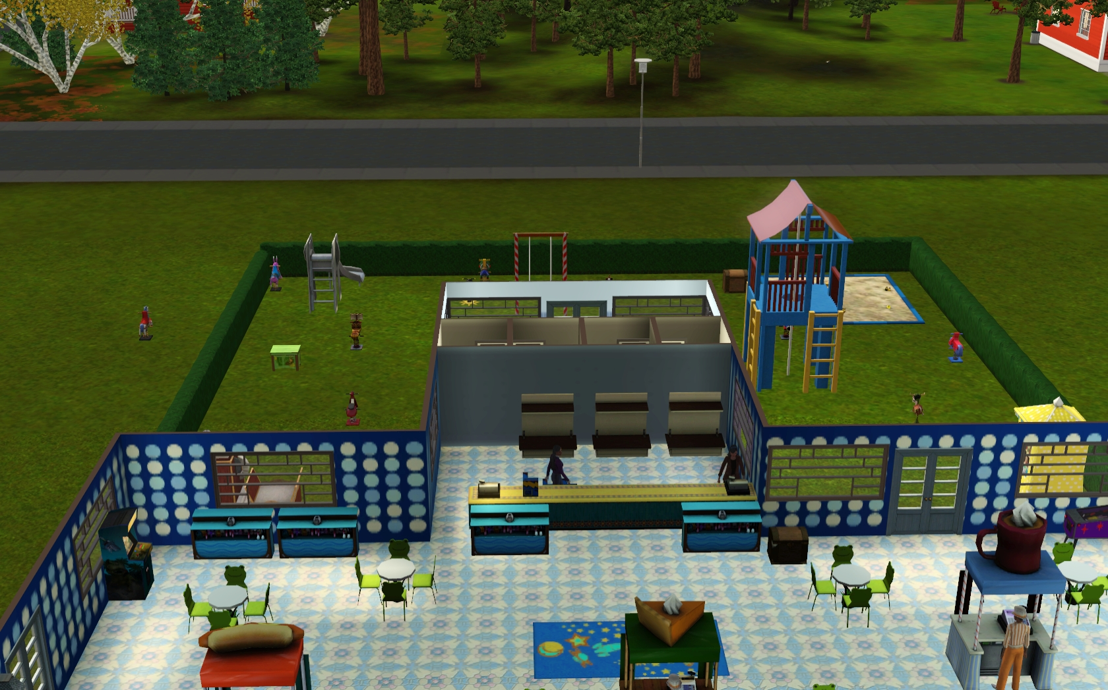
Gift shop
The gift shop will include:
T-shirts
Qr cards for the mobile game
Toys / Stuffed animals
Postcards
Posters
Keychains

Slide 26
Commercial Constraints
We have taken into account the following estimations when calculating the commercial constraints for the project.
Cost estimations
Project time scale estimations
We have carried out some basic calculations, to calculate the potential cost of the project. The calculations were based on estimated factors such as:
The estimated staff costs and the total hours of work that is required to complete the work.
The project costs/resources
The required profit margin

Slide 27
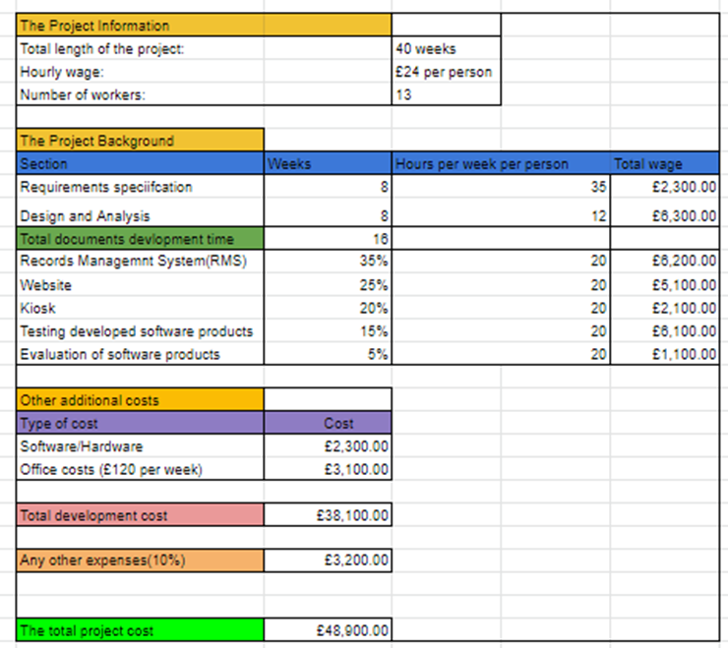
Project cost calculations

Slide 28
Conclusion
We really appreciate you taking time to join us for this presentation today.
If you have any outstanding questions, please feel free to ask, as we have now come to the conclusion of the presentation.
Notes:
Conclusion: We really appreciate you taking time to join us for this presentation today. If you have any outstanding questions, please feel free to ask. * They ask questions* - Once again thank you for your time, we hope to hear from you soon about taking the next steps into developing the software products.

